Slide 1
Classifying Blood Cells
Diagnosis of blood-related diseases often require labeling and characterizing elements of the patient's blood sample. Given a microscopic picture of blood, the algorithms must identify, count and label the cells. The output differentiates the red blood cells, white blood cells and platelets utilizing image segmentation methods.
João Vitor Guino Rieswick, nº 9283607
Notes:
Objetivo: dado imagem microscópica, identificar 3 tipos de células: Hemácias, Glóbulos Brancos e Plaquetas

Slide 2
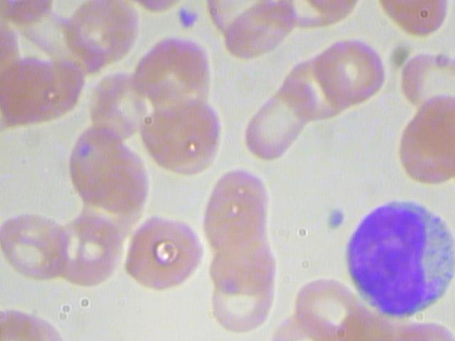
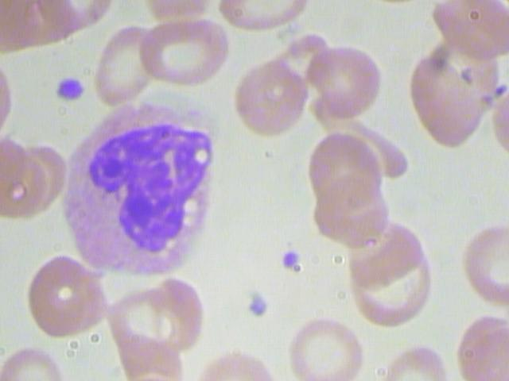
Example of input images from the dataset
At first glance:
Both white blood cells (WBC) and platelets are blue/purple, while red blood cells have a red hue.
Platelets are the smallest elements in the picture, while WBCs are much bigger.
Notes:
Blood Cell Count Dataset. Usada para machine learning, minha solução não envolve qualquer forma de treinamento ou pré-processamento

Slide 3
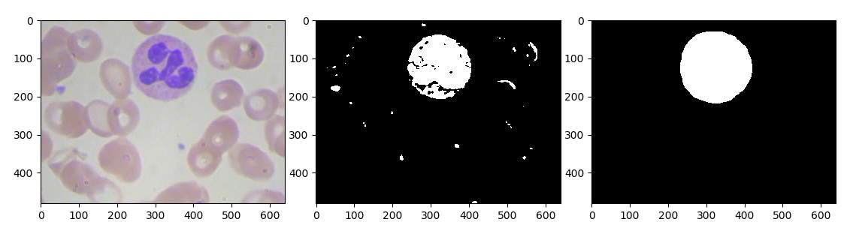
Extracting and labelling white blood cells
1
Color segmentation!
Conversion from RGB to HSV.
Mask specific range of values.
Series of morphological operations.
Notes:
Primeiro passo, começando pelos glóbulos brancos.Open, Closing, Dilatação, Erosão.

Slide 4
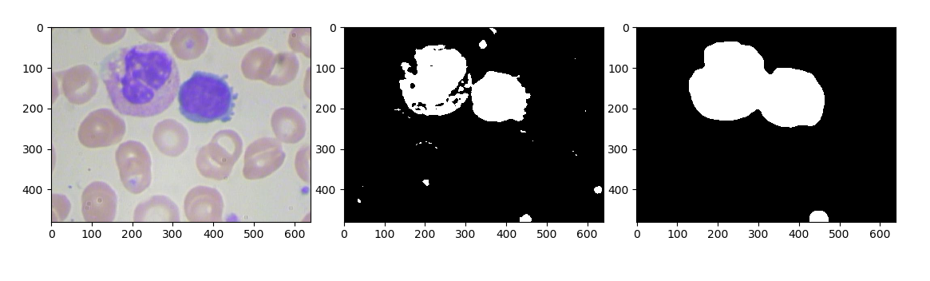
Extracting and labelling white blood cells
1
Needs polish!
Good for selecting areas, not good enough for counting.
Might join different WBCs into only one.

Slide 5
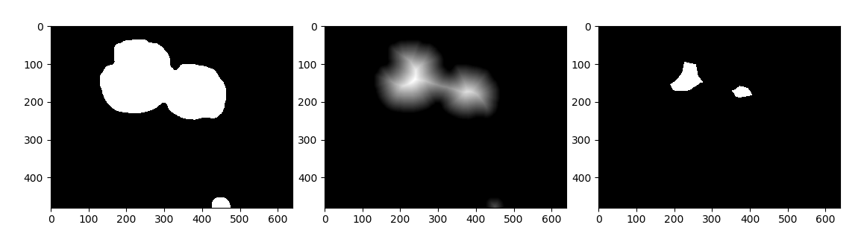
Extracting and labelling white blood cells
1
One way to solve it:
Distance transforming WBC’s mask.
Applying certain threshold to transformed mask leaves us with only the center of each WBC.
Now we know the correct number of WBCs in the picture.

Slide 6
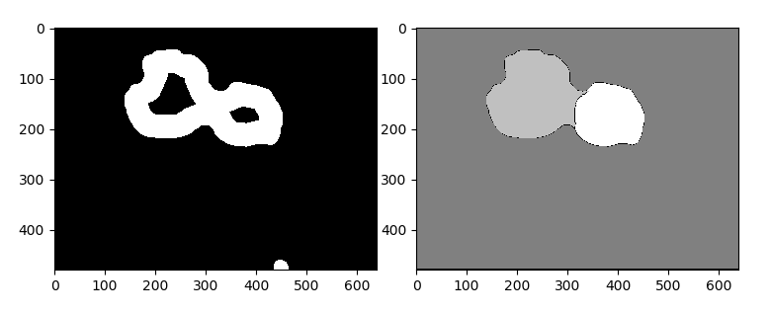
Extracting and labelling white blood cells
1
Finishing touches:
Bind WBC mask with threshold mask to obtain “unknown region” mask.
The watershed algorithm expands each “center” of the mask, resulting in a good approximation of area for each element.
Notes:
Bacio hidrográfica, represa.

Slide 7
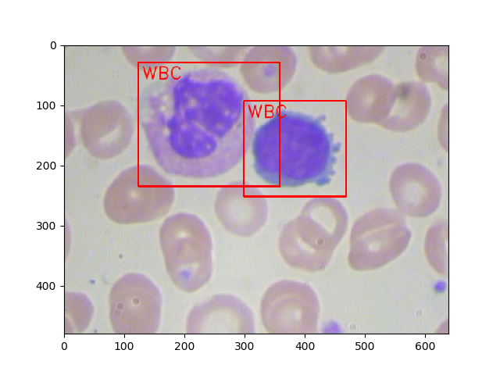
Extracting and labelling white blood cells
1
Results:

Slide 8
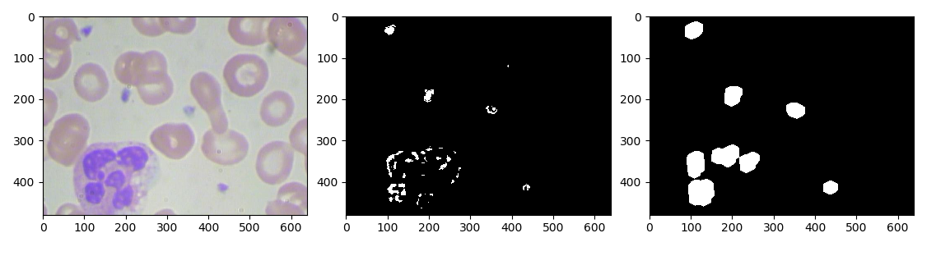
Extracting and labelling platelets
2
They are not so different from WBCs in terms of color…
It starts the same!
Conversion from RGB to HSV.
Mask specific range of values.
Series of morphological operations.
Notes:
Mas tem um problema!

Slide 9
Extracting and labelling platelets
2
They are not so different from WBCs in terms of color…
It starts the same!
Conversion from RGB to HSV.
Mask specific range of values.
Series of morphological operations.
NOT PLATELETS!
Notes:
Há milhões de maracutaias que podem ser feitas aqui.

Slide 10
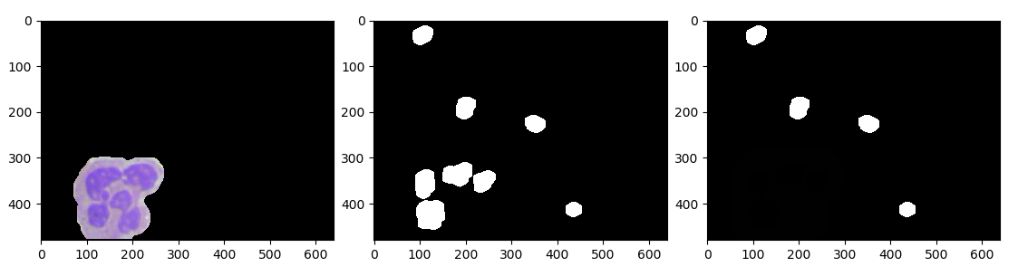
Extracting and labelling platelets
2
Easy fix! The WBC mask was already calculated...
All we gotta do is remove the WBC by subtracting both masks!
(This is done before the morphological transformations, so as not to let dilated parts of WBC reminiscents appear)

Slide 11
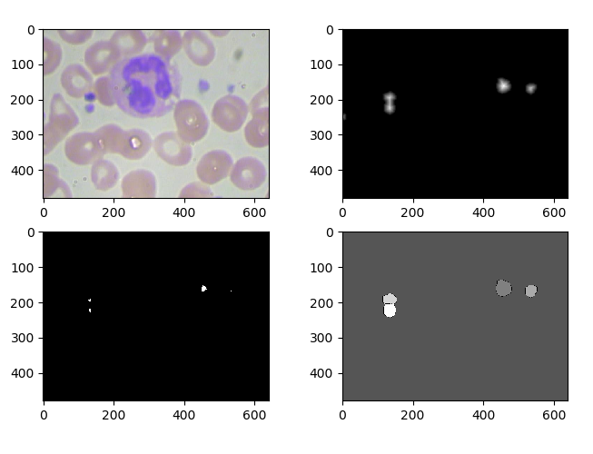
Extracting and labelling platelets
2
Same distance, threshold, and watershed are applied to the platelets
There are also few but specific cases where 2 platelets are too close and end up being counted as only one.

Slide 12
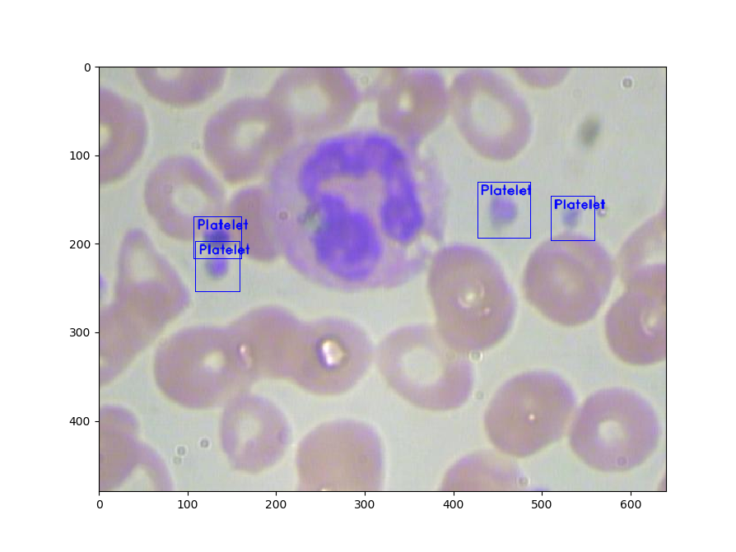
Extracting and labelling platelets
2
Results:
Notes:
Aquela mancha escura… como não é um tom de azul/roxo, não interfere.

Slide 13
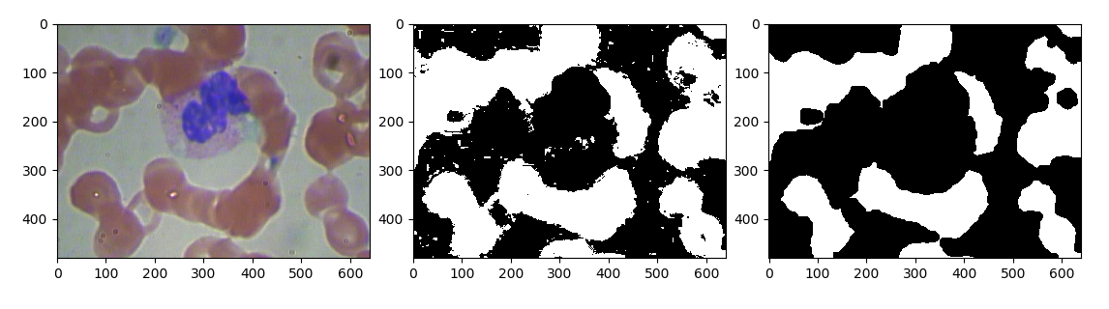
Extracting and labelling red blood cells
3
Different color, same beginning!
Conversion from RGB to HSV.
Mask specific range of values.
Series of morphological operations.

Slide 14
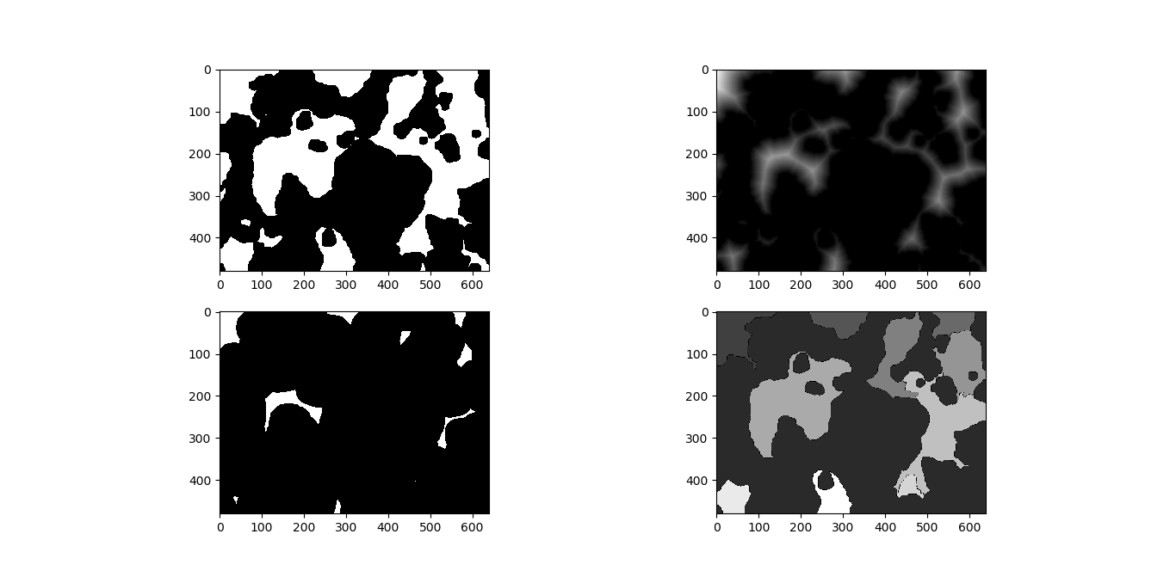
Extracting and labelling red blood cells
3
Problem! The same process from now on won’t work.
Due to a lack of constant shape, the algorithms will separate the mask into regions, not individuals cells.

Slide 15
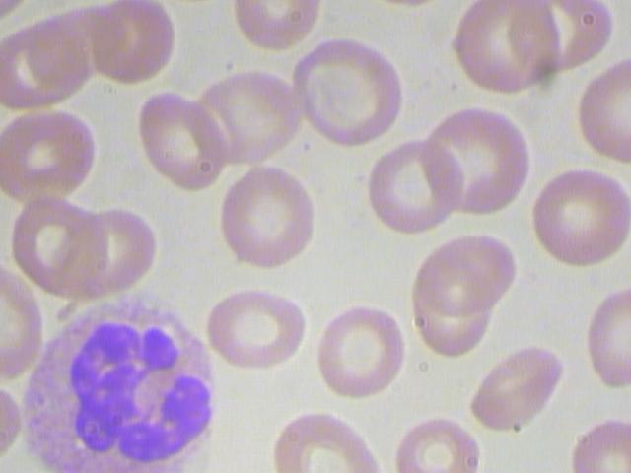
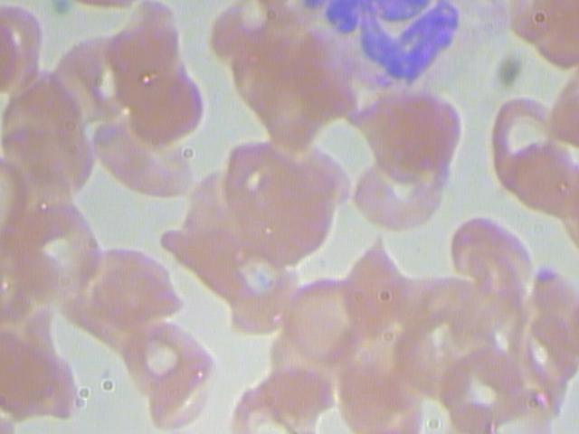
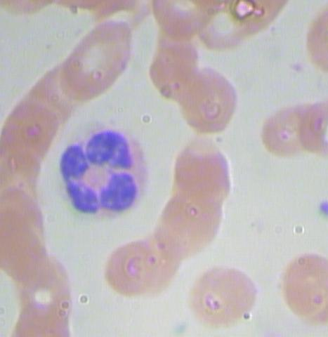
Extracting and labelling red blood cells
3
Solution: Using a different approach.

Slide 16
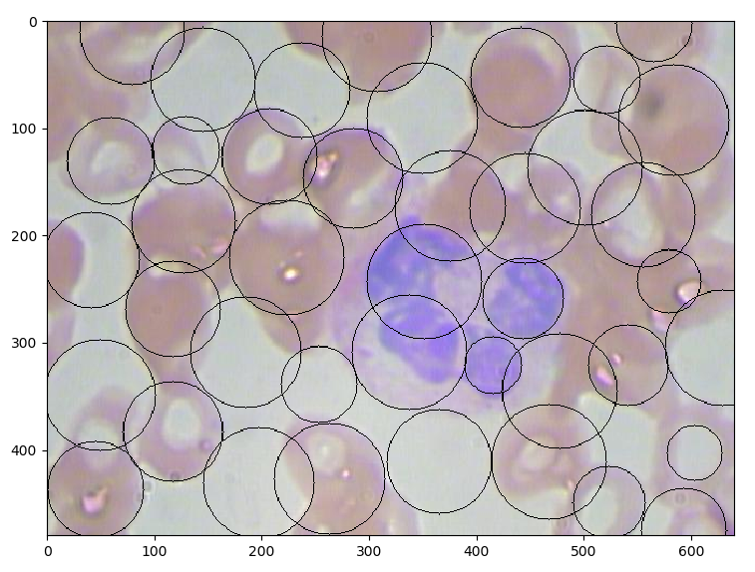
Extracting and labelling red blood cells
3
Solution: Circle Hough Transform
Besides not being constant in shape, they are still, for the mos part, oval.
CHT is a feature extraction technique for detecting circles.

Slide 17
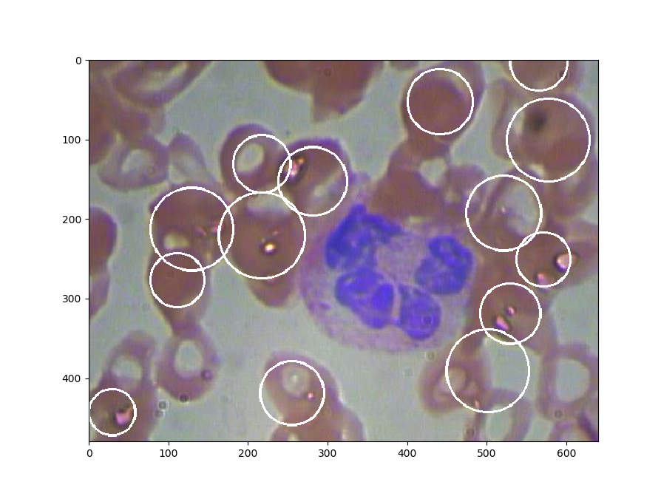
Extracting and labelling red blood cells
3
Results:

Slide 18
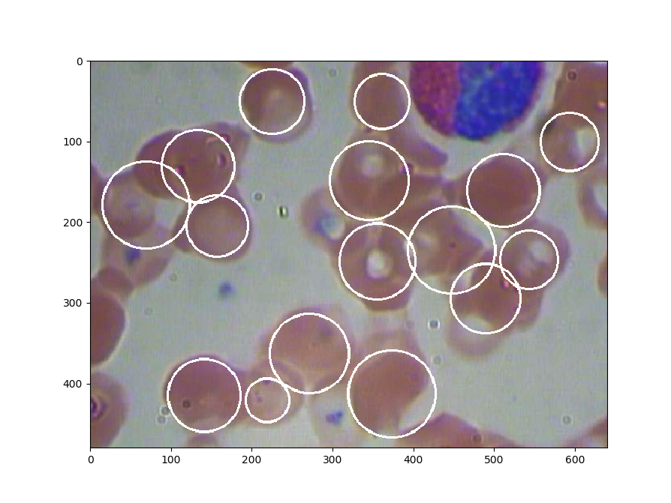
Extracting and labelling red blood cells
3
Results:

Slide 19
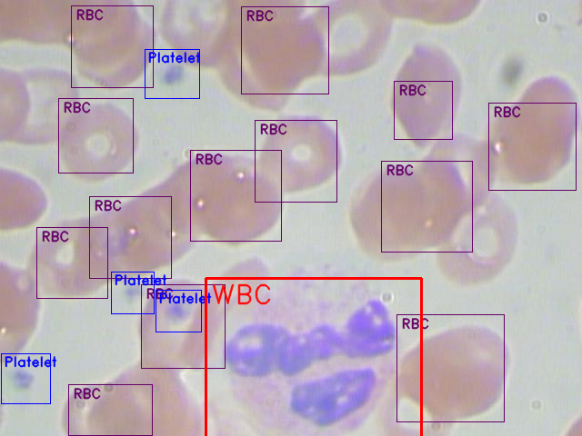
Final result
4
General accuracy of 87,6%, considering total number WBC, RBC and Platelets found compared to the dataset annotation files.
WBC: 94.4%
RBC: 87.5%
Platelets: 82.0%

